Slide 1
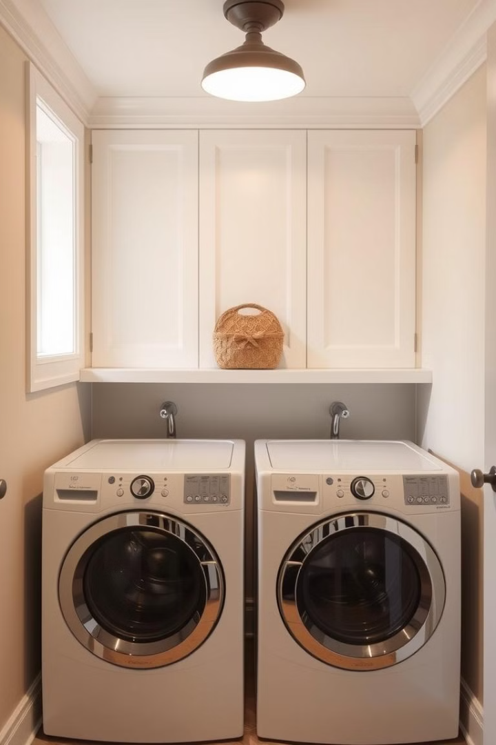
IDSE Project
Predictive Analysis of Laundry Room Operations
P. AKSHITH ME22B2020
JAYA SURYA. N ME22B2015

Slide 2

Introduction and Objective
1
Problem Statement
The college laundry room faces machine shortages and long wait times due to high Crowd and might lead to misuse of machines due to fluctuating demand. Predicting user demand patterns can help optimize machine usage, reduce wait times, and improve laundry room efficiency.
2
Objective
Develop a Model to that forecast user demand . Aiming to identify Peak usage time optimizing machine allocation.

Slide 3
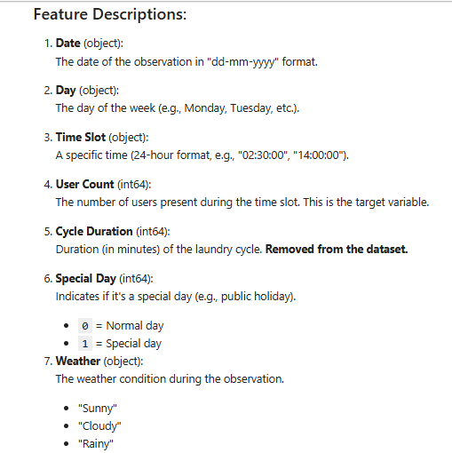
Data Collection
Dataset Overview
Key Features (Data Required)
Daily records, including user counts, timestamps, day of the week, time slot, weather conditions, and special days.
Small Dataset with less than 1000 points
User Count (Output variable)
Date & Time Slot (Input variable)
Weather (Input variable)
Special Day (Input Variable)
Data Sources
Data was collected from Hostel Laundry Logs. Cleaning and preprocessing steps were applied to ensure quality.

Slide 4
Data Preprocessing
Handling Missing Values
Feature Engineering
Data Discretization
Forward fill and removed rows with too many missing values.
Date and Time were combined into a single Timestamp. Extracted new features like day of the week, hour, and month.
Features like time slot and User Count where Discretized to form new features for better understanding and categorization .

Slide 5
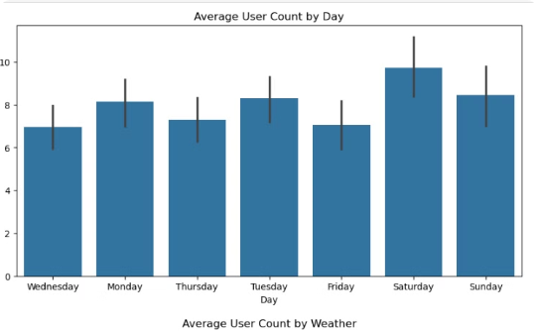
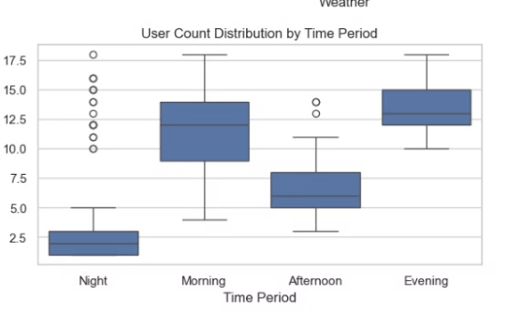
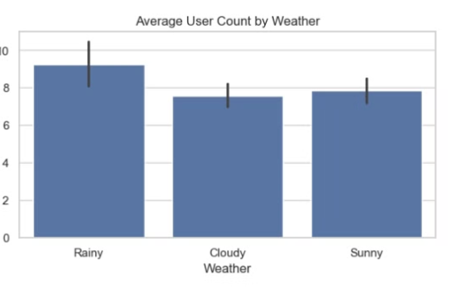
Exploratory Data Analysis (EDA)
User Count by Day of the Week
User Count by Time Period
Effect of Weather and Holidays
Weekends have a significantly higher user count.
Usage peaks around mid-morning and early evening.
Special days like holidays or sunny weather tend to see higher usage.

Slide 6
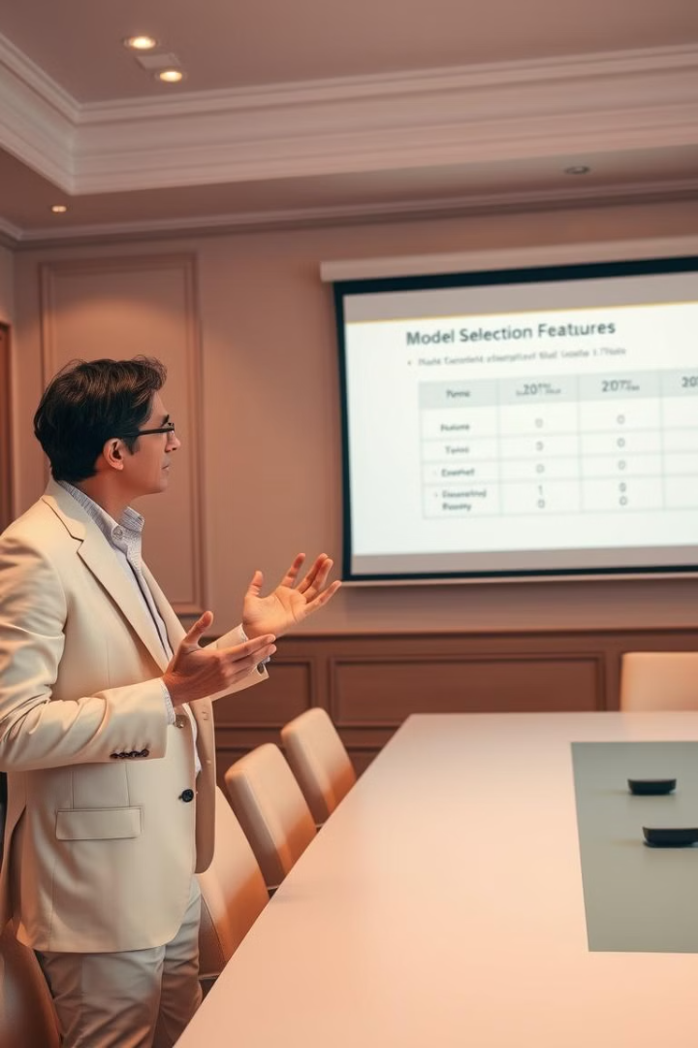
Feature Selection and Model Selection
Feature
Significance
Day of the Week
Certain days are busier than others.
Hour
Helps capture peak times of day.
Weather & Special Days
Special days and weather can influence user behavior.
Model Selected –Linear Regression . Why ?
Simple and Interpretable : Can capture simple linear relationships.
Continuous Output : The continuous nature of output (User Count)
Efficiency on Small to Medium-Sized Datasets

Slide 7
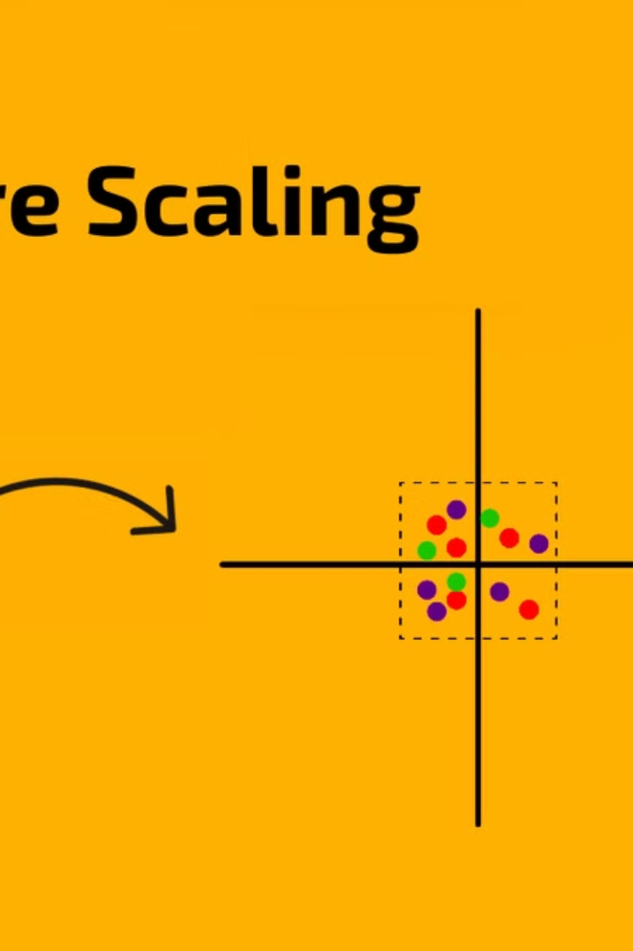



Model Training and Testing
Train-Test Split
The data was split into 80% training and 20% testing sets.
Feature Scaling Applied
StandardScaler was applied to numeric features. (Trivial In this case)
Model Training
Trained the Linear Regression model on Scaled values.

Slide 8

Possible Solutions
1
Optimal Usage Hours
Based on our predictions, users could avoid peak hours such as mornings of weekends
2
Resource Allocation:
In High-demand periods, more resources(like additional machines)
could be allocated to prevent over-crowding.
3
User Scheduling:
A user Scheduling system that encourages usage during the low-demand times and temporary blocking of machines(to not overuse machines) could help even out usage patterns.

Slide 9
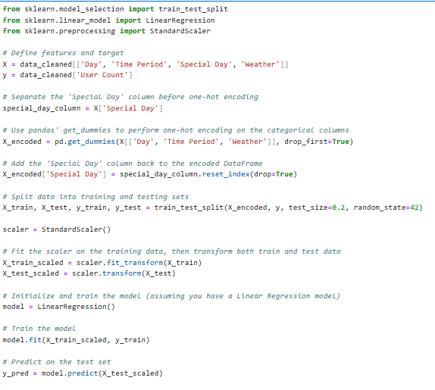
Relevant Code
1
Model Performance
2
Interpretation of Results

Slide 10
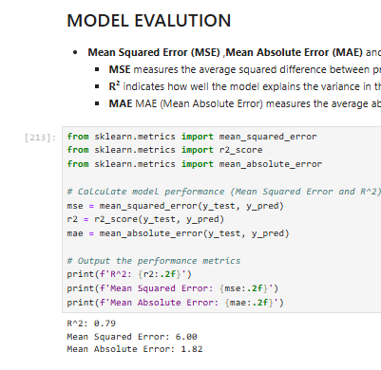


Evaluation Metrics
MSE
R² Score
Lower MSE indicates better performance.
Values closer to 1 are better
The Results indicate that the linear regression model has well captured the variance of the data.

Slide 11
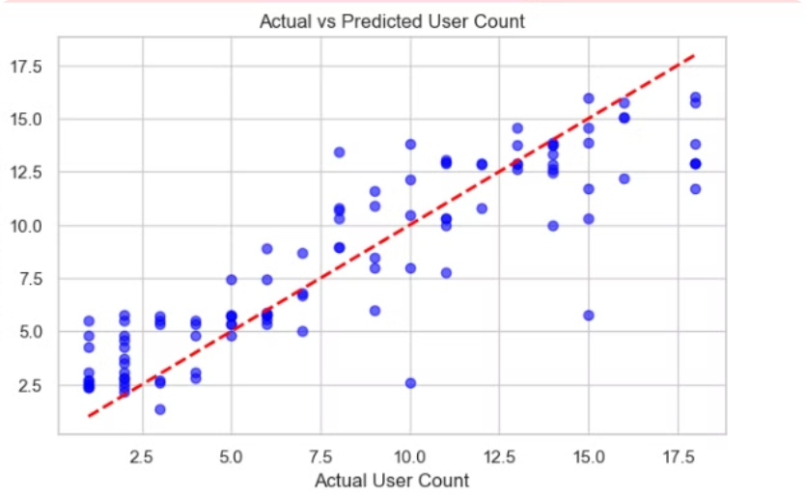
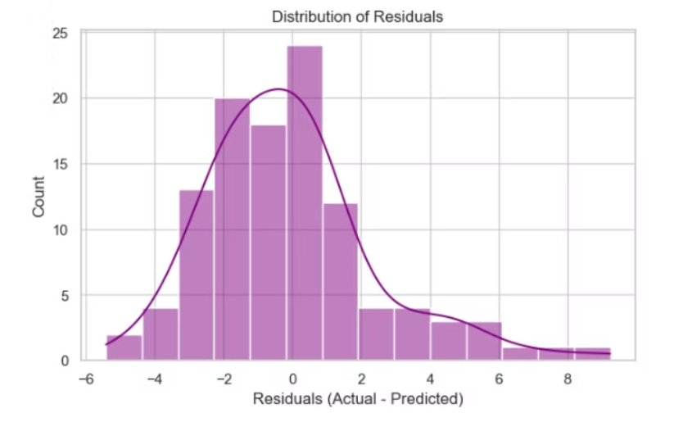
Visualization of Results
Sample Predictions vs. Actual Data
Actual-Predicted Plot for Result
Model predictions vs. actual data
User count Fit(predicted) vs Actual

Slide 12

Challenges and Limitations
Data Limitations
This dataset may not well capture the variables that influences the
laundry room usage like user habits.
The Model Constraints
The Linear regression model used may not well capture the
non linear relationships due to it’s simplicity.
Size of the Dataset
Due to it’s small size of dataset, it’s performance could get effected and risk overfitting. Bigger dataset would have yielded better returns .

Slide 13

Future work & Possible Enhancements
Additional Features
Including the details weather, real-time room occupancy for further
Improvement of model.
Alternative Models
Models like Random Forest, ARIMA, Neutral network can capture the
complex patterns really well compared to linear regression.
User Interface
Building a user-friendly that shows optimal laundry room times could directly impact user satisfication.

Slide 14

Conclusion
Impact
Implementing this model could reduce wait times, Optimize machine usage, can create better overall user experience.

